Slide 1
CellProfiler Workshop
CRUK-SI
Nikki R. Paul
BAIR
20250709

Slide 2
Outline
9:30 – ~10:30
Introduction – What is CellProfiler? Why use it?
CellProfiler interface
Importing images
Creating pipelines and testing
~10:30 – 11:00 BREAK
11:00 – 12:00
Segmentation of primary, secondary and tertiary objects – a live example
12:00 – 13:00 LUNCH
13:00 - ~14:30
Work through examples
~14:30 – 14:50 BREAK
14:50 – ~15:30
Work through examples
15:30 – 16:00 Wrap-up, how would you use CP? CP Analyst?

Slide 3
Introduction
Intended Learning Outcomes:
Introduction – What is CellProfiler?
Why use CellProfiler vs other image analysis software?
Where to get help with CellProfiler?
CellProfiler interface
Importing images
Creating pipelines and testing

Slide 4

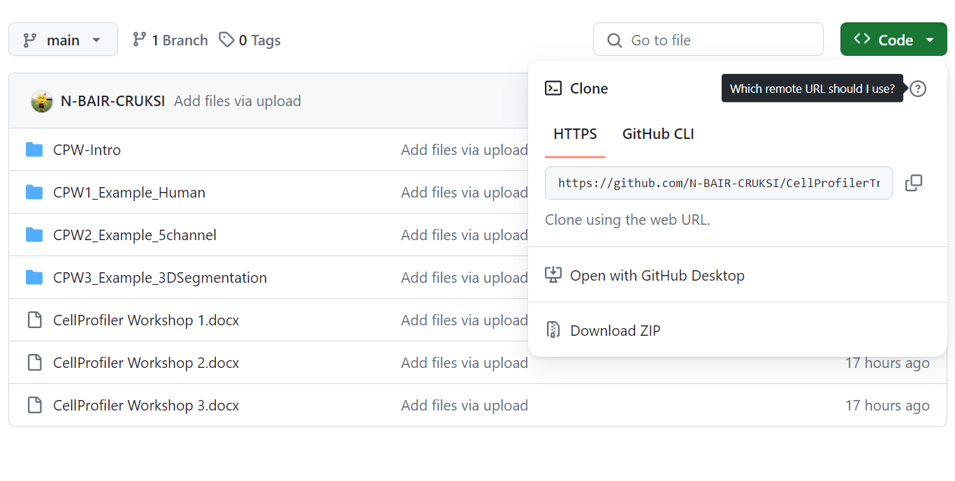
Before we start . . .
Please go to: https://github.com/N-BAIR-CRUKSI/CellProfilerTraining2025
Click on Code, Download Zip.
Once Downloaded, Extract All.
Save to Desktop.
IMPORTANT! Today don’t use the Onedrive locations (Desktop/Documents etc.) for anything we do, as CellProfiler does not like this!

Slide 5

What is CellProfiler?
Free! Image Analysis Software
Open source – can be used by anyone.
Project started in 2003: Anne E. Carpenter and Thouis (Ray) Jones in the Sabatini Laboratory and Golland laboratory.
Now Beth Cimini Lab at the Broad Institute of MIT and Harvard.

Slide 6




Why CellProfiler?
Complementary to other image analysis software e.g. Fiji.
Much easier to build analysis pipelines and batch image analysis.
No coding experience required.
Can export images and measurements easily.
Project and pipeline organisation and sharing.
Possible to import data for machine learning in CellProfiler Analyst.

Slide 7
Why I use it?
Batch image analysis, especially fluorescent images.
Nuclei counting.
Cell counting and area measurement.
Spot counting inside cells.
Scratch-wound analysis.
Colony counting – e.g. crystal violet staining.
I will use a Menti poll later to see what you may use it for.

Slide 8
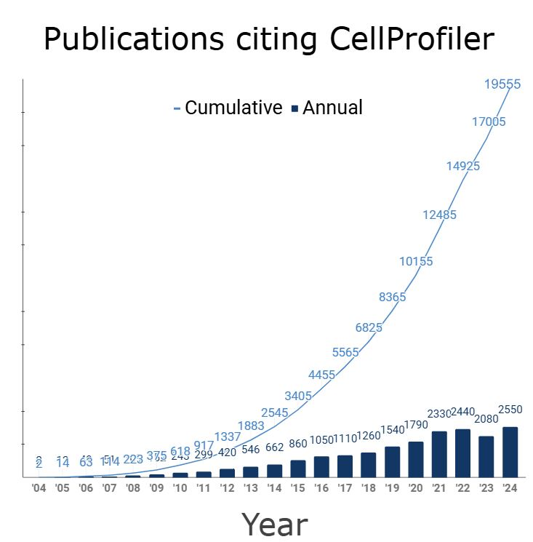
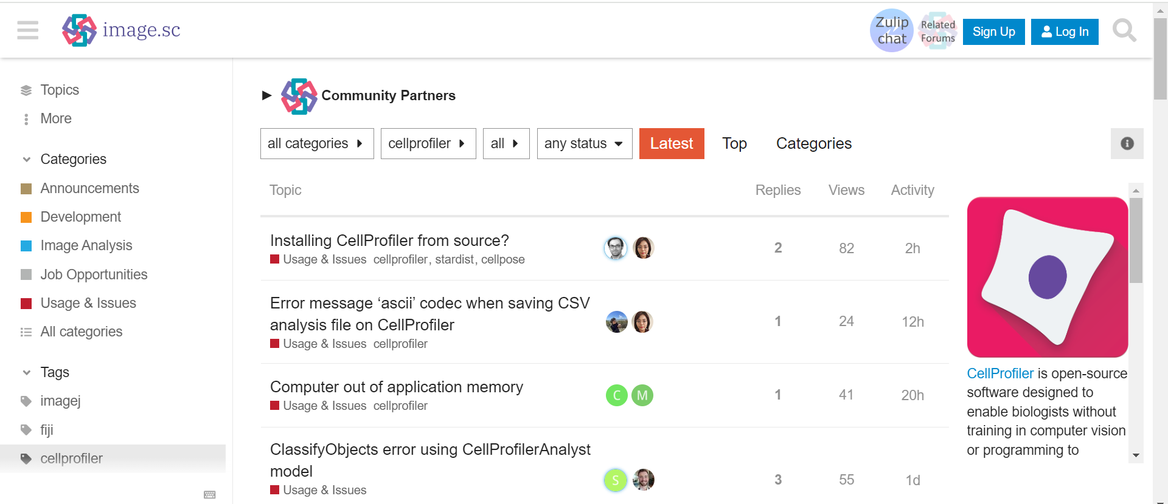
Help with CellProfiler?
BAIR
CellProfiler website: https://cellprofiler.org/
Examples and Tutorials
Manuals
Published Pipelines (care with versions)
ImageJ.sc forum: https://forum.image.sc/tag/cellprofiler
YouTube:
https://www.youtube.com/watch?v=eriZdORpFxs
CellProfiler workshop from COBA

Slide 9
Important!
If you use CellProfiler for analysis in your publication:
Please author/acknowledge BAIR if you have had help from us.
Cite the CellProfiler developers:
Stirling DR, Swain-Bowden MJ, Lucas AM, Carpenter AE, Cimini BA, Goodman A (2021). CellProfiler 4: improvements in speed, utility and usability. BMC Bioinformatics, 22 (1), 433. . PMID: 34507520 PMCID: PMC8431850. doi. pdf.
McQuin C, Goodman A, Chernyshev V, Kamentsky L, Cimini BA, Karhohs KW, Doan M, Ding L, Rafelski SM, Thirstrup D, Wiegraebe W, Singh S, Becker T, Caicedo JC, Carpenter AE (2018). CellProfiler 3.0: Next-generation image processing for biology. PLoS Biol. 16(7):e2005970. PMID: 29969450. doi.
Stirling DR, Carpenter AE, Cimini BA (2021). CellProfiler Analyst 3.0: Accessible data exploration and machine learning for image analysis. Bioinformatics. PMID: 34478488. doi. pdf (Research article)

Slide 10
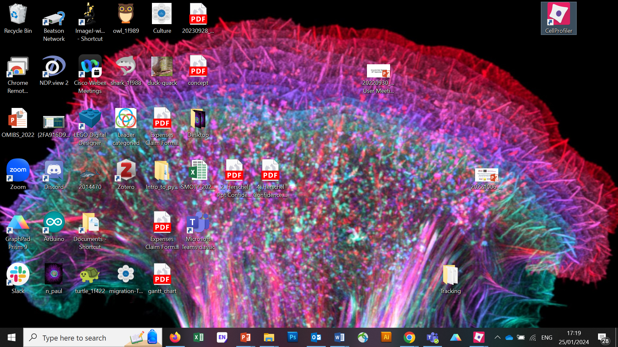
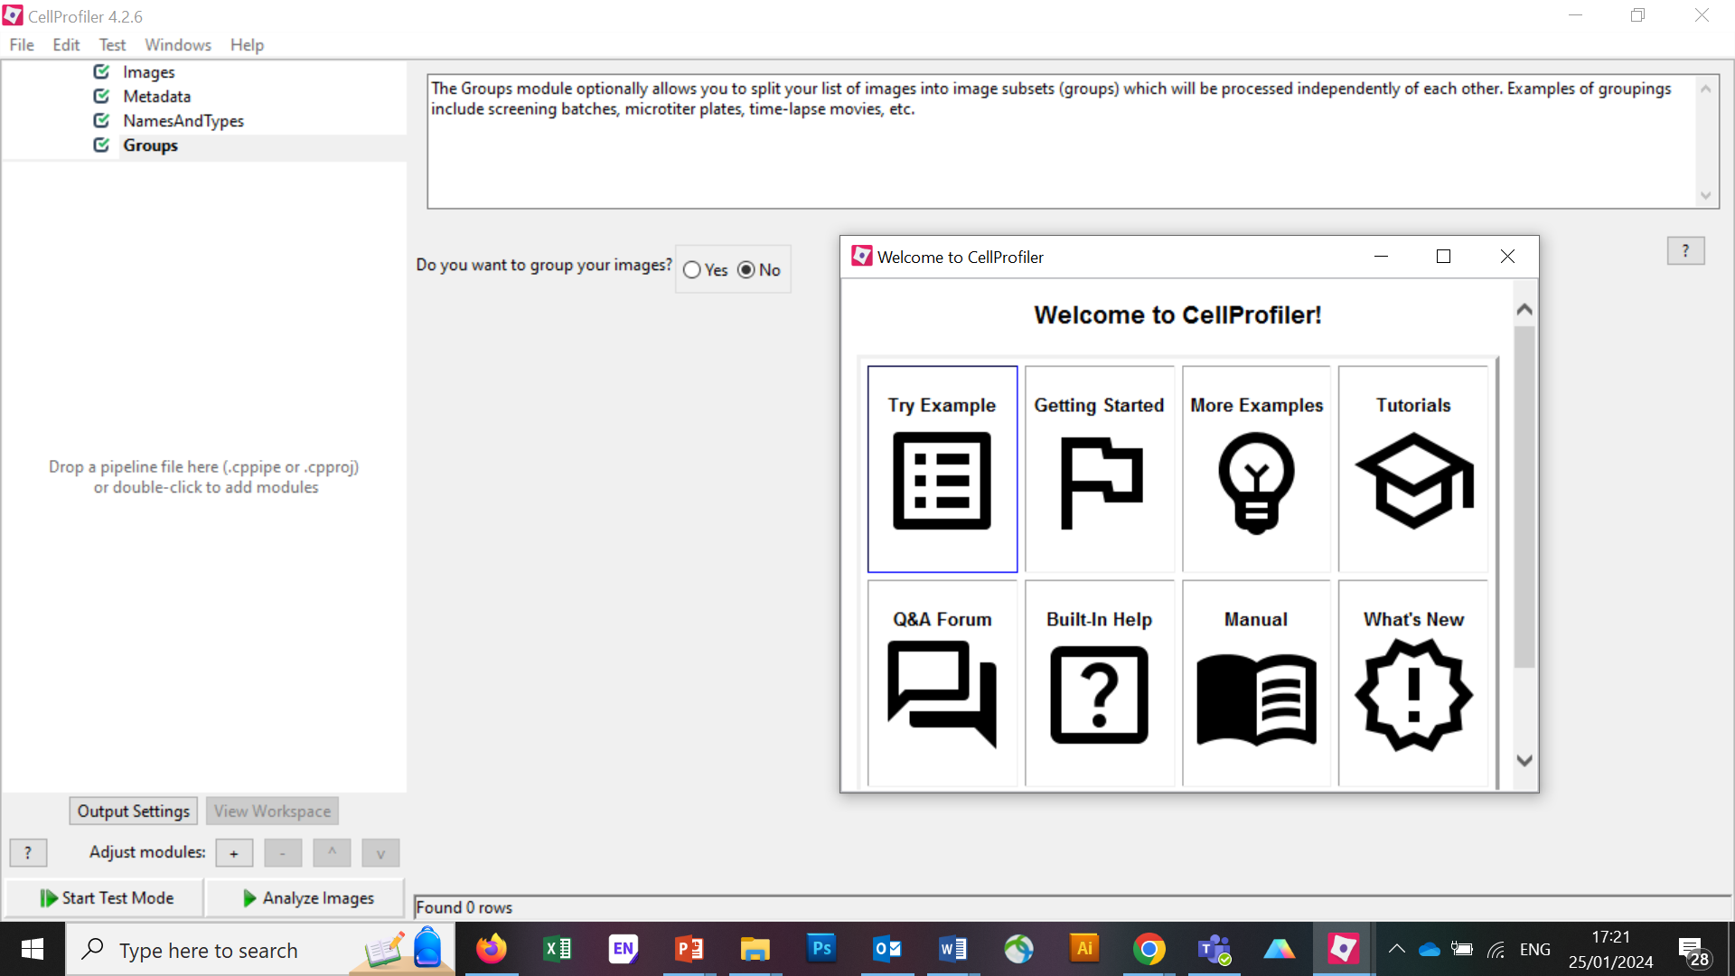
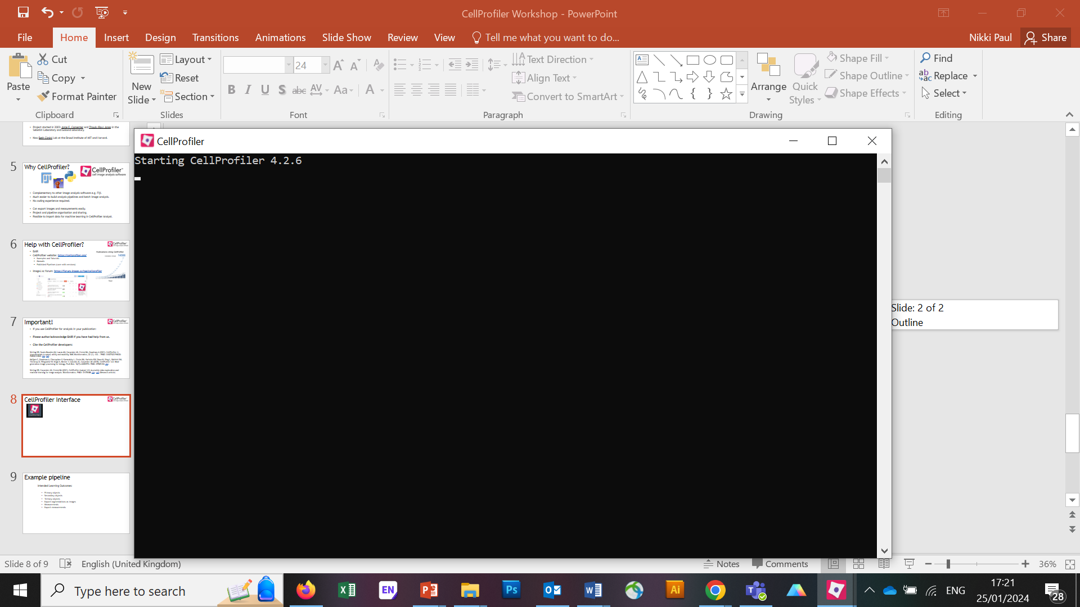
CellProfiler Interface

Slide 11
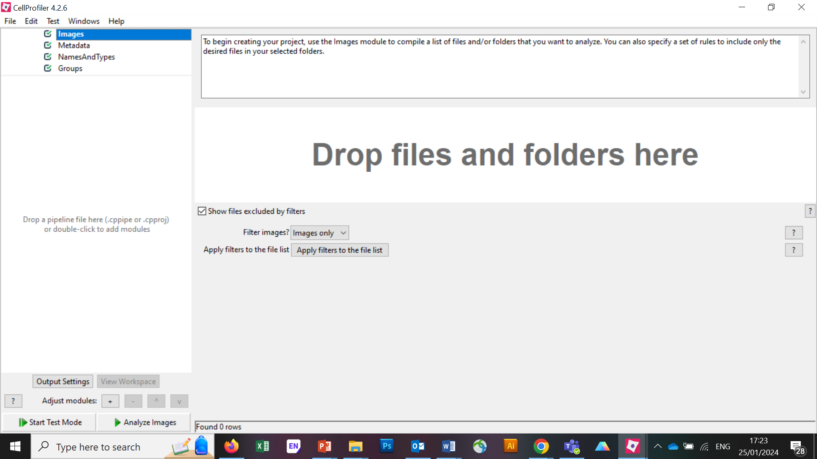
CellProfiler Interface

Slide 12
CellProfiler Interface

Slide 13
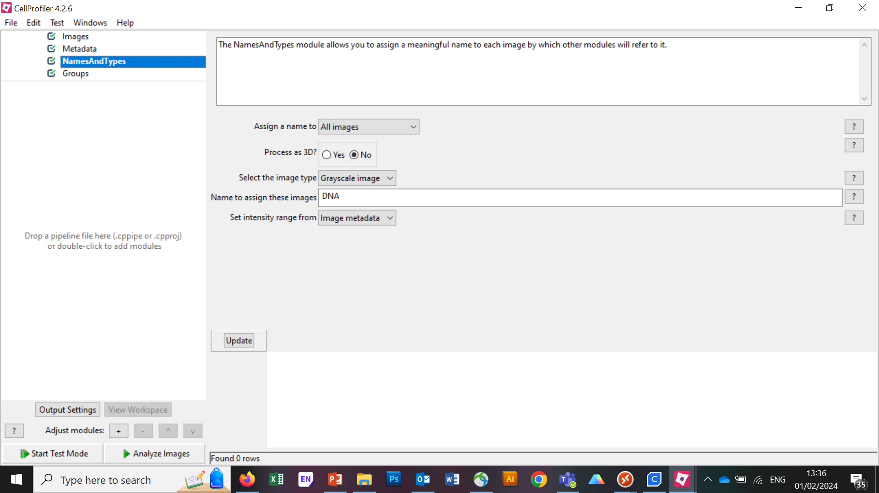
CellProfiler Interface

Slide 14
CellProfiler Interface

Slide 15
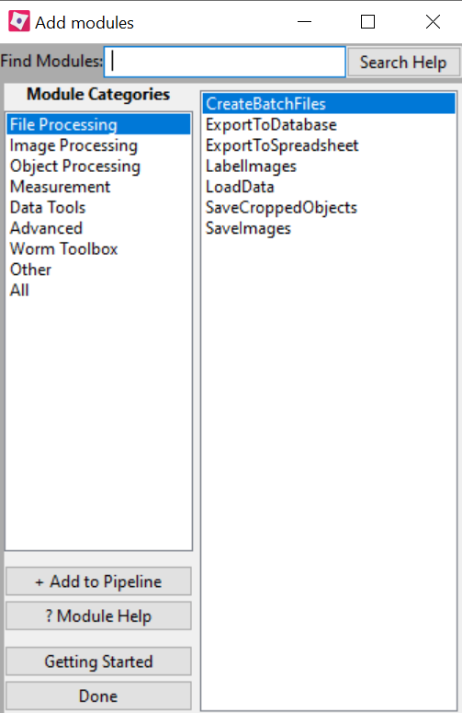
CellProfiler Interface

Slide 16
CellProfiler Interface

Slide 17
CellProfiler Interface
Help buttons

Slide 18
Importing Images
U20S osteosarcoma cell line.
FOXO1A labelled with GFP (channel 1).
DNA stained to mark nuclei (channel 2).
Normally localised to the cytoplasm (continuous nuclear export).
Upon inhibition of nuclear export, FOXO1A accumulates in the nucleus.
Positive control: 150nM Wortmannin treatment.
Can we identify the difference in nuclear localisation in control and treated cells?
Full tutorial available here: https://tutorials.cellprofiler.org/#translocation

Slide 19
Importing Images
On the ‘Images’ tab, drag the entire ‘CPW-Intro’ folder into the ‘Drop files and folders here’ box.

Slide 20
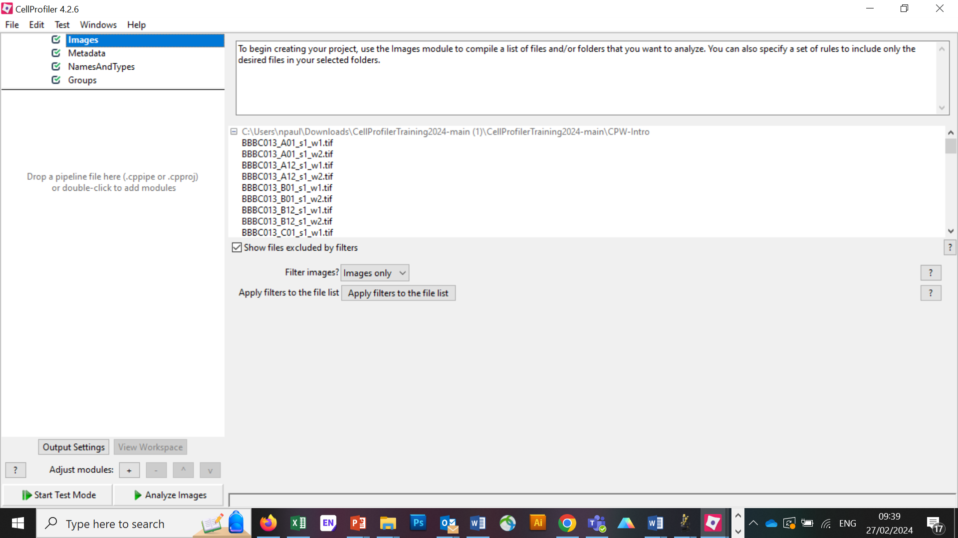
Importing Images
On the ‘Images’ tab, drag the entire ‘CPW-Intro’ folder into the ‘Drop files and folders here’ box.

Slide 21
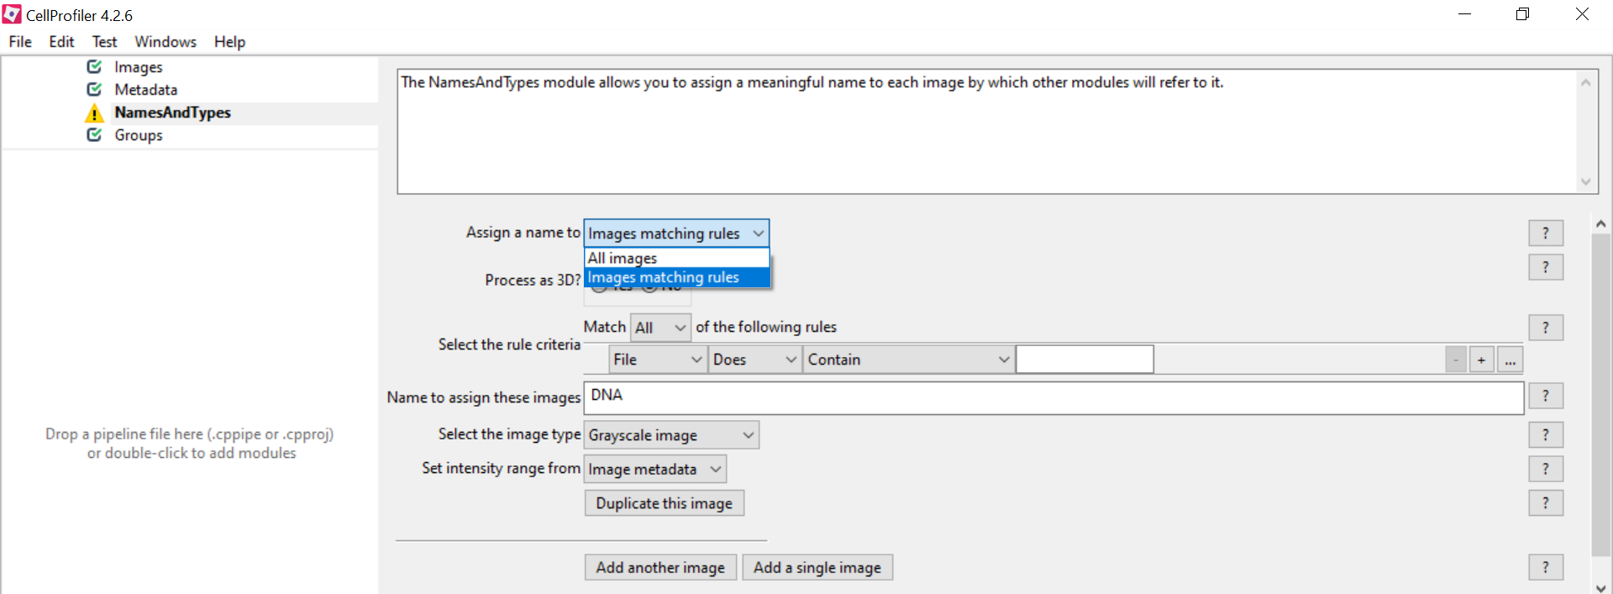
Importing Images
Go to ‘Names and Types’. Your images are in pairs where ‘_w1’ = GFP and ‘_w2’ = DNA.
We are going to tell the software to assign the images with the appropriate names using the ‘Images matching rules’ function.

Slide 22
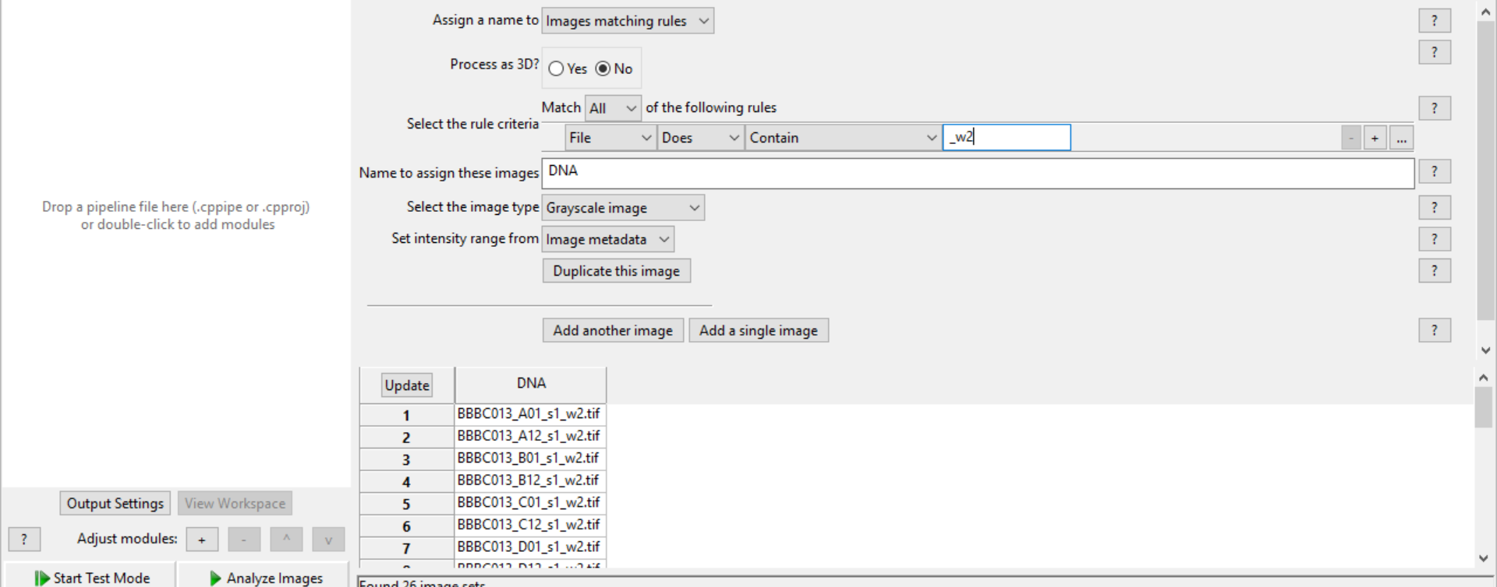
Importing Images
Assign the name ‘DNA’ to files that contain ‘_w2’ in the filename and click update.

Slide 23
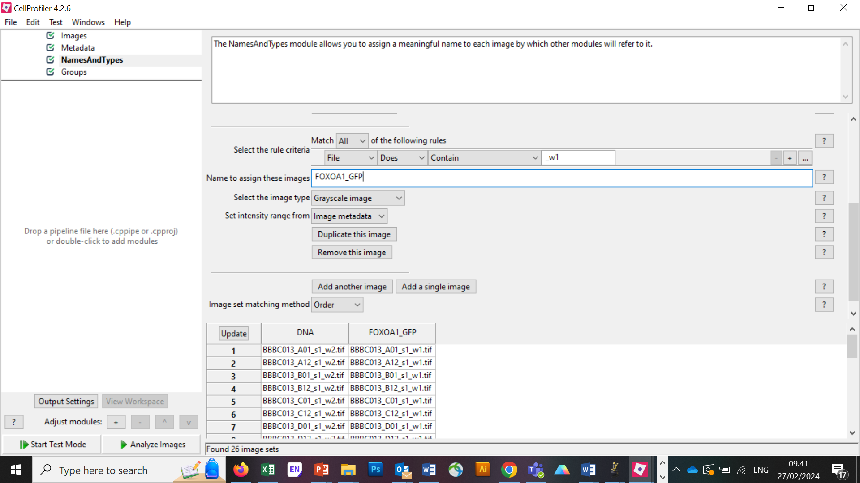
Importing Images
Add another image and repeat for ‘FOXO1A_GFP’ and ‘_w1’. Click update and check all images in the folder are recognised.

Slide 24
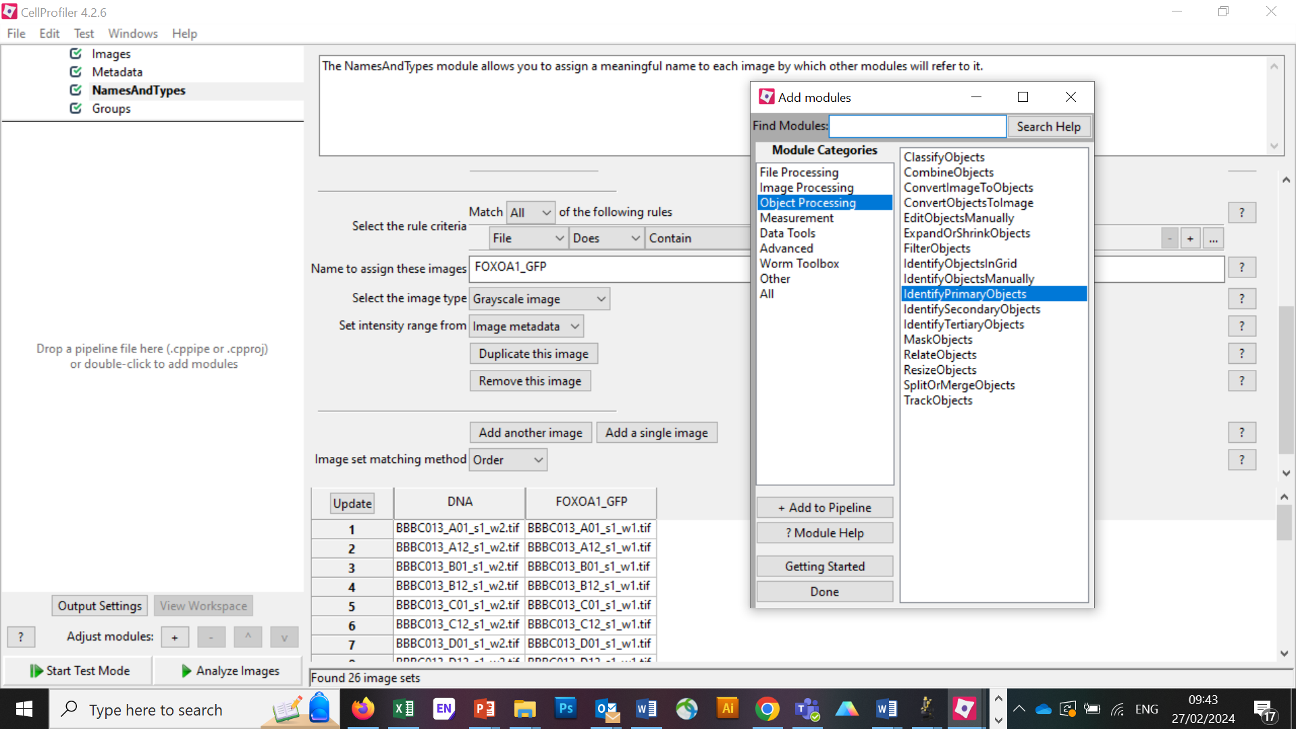
Identify Primary Objects
Add module -> Object Processing -> IdentifyPrimaryObjects -> Add to pipeline

Slide 25
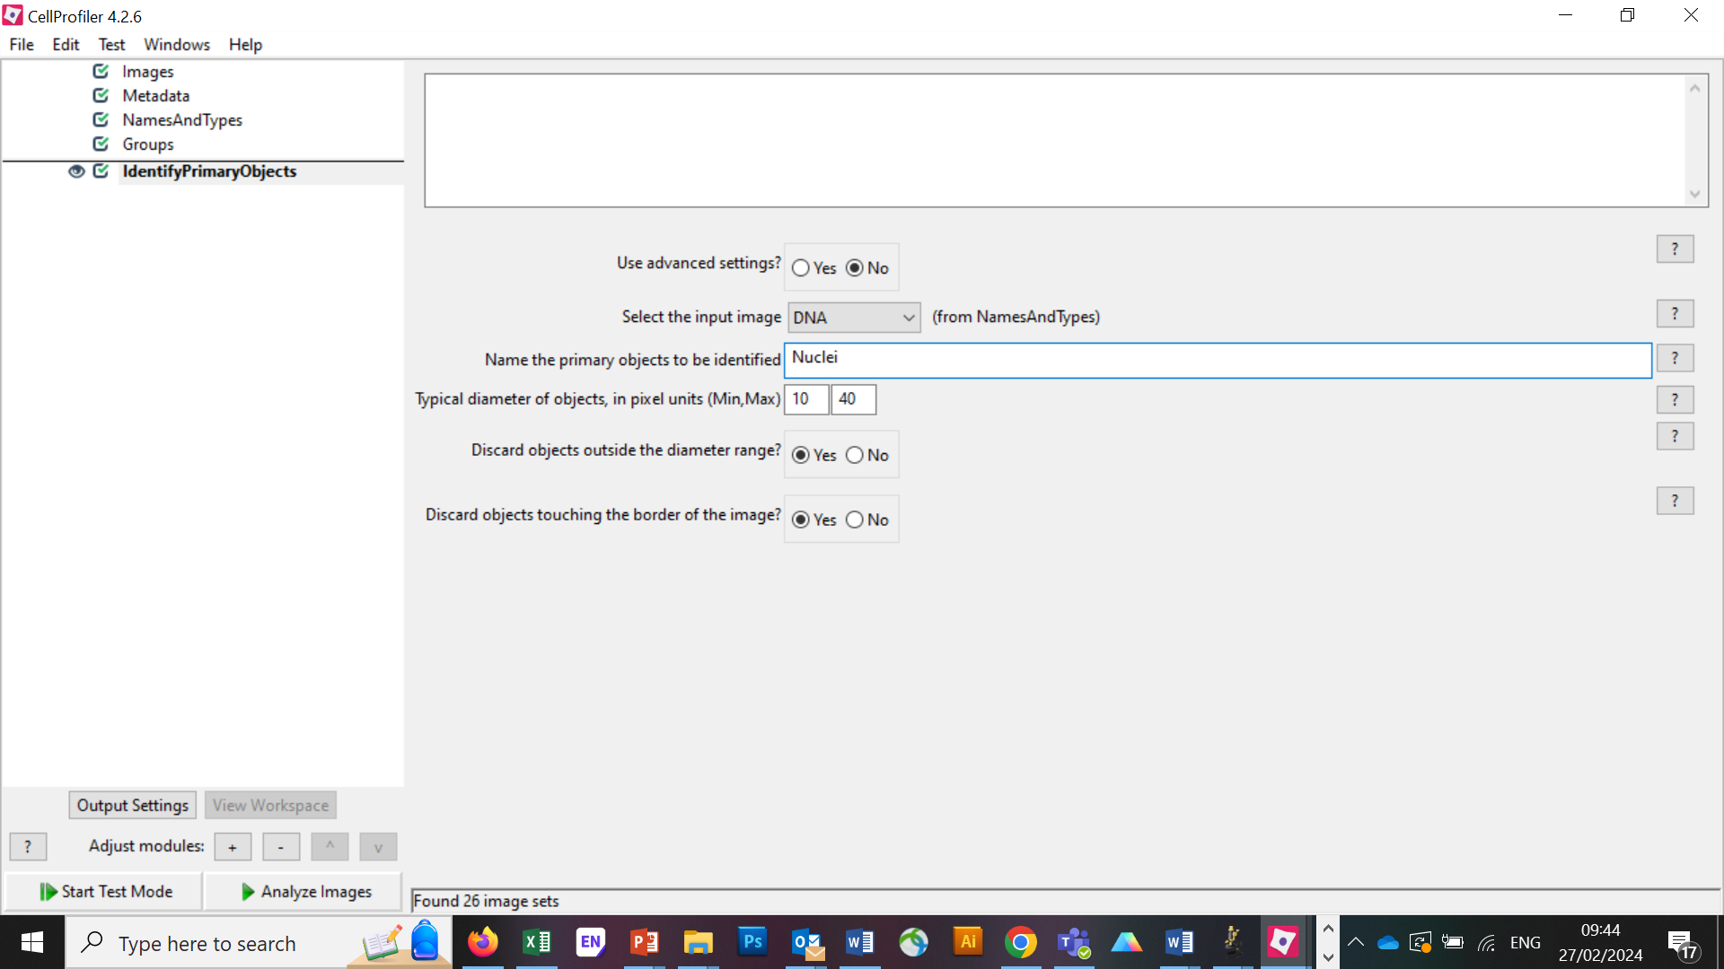
Identify Primary Objects
Select the Input image as ‘DNA’ and name it Nuclei. Test the basic settings.

Slide 26
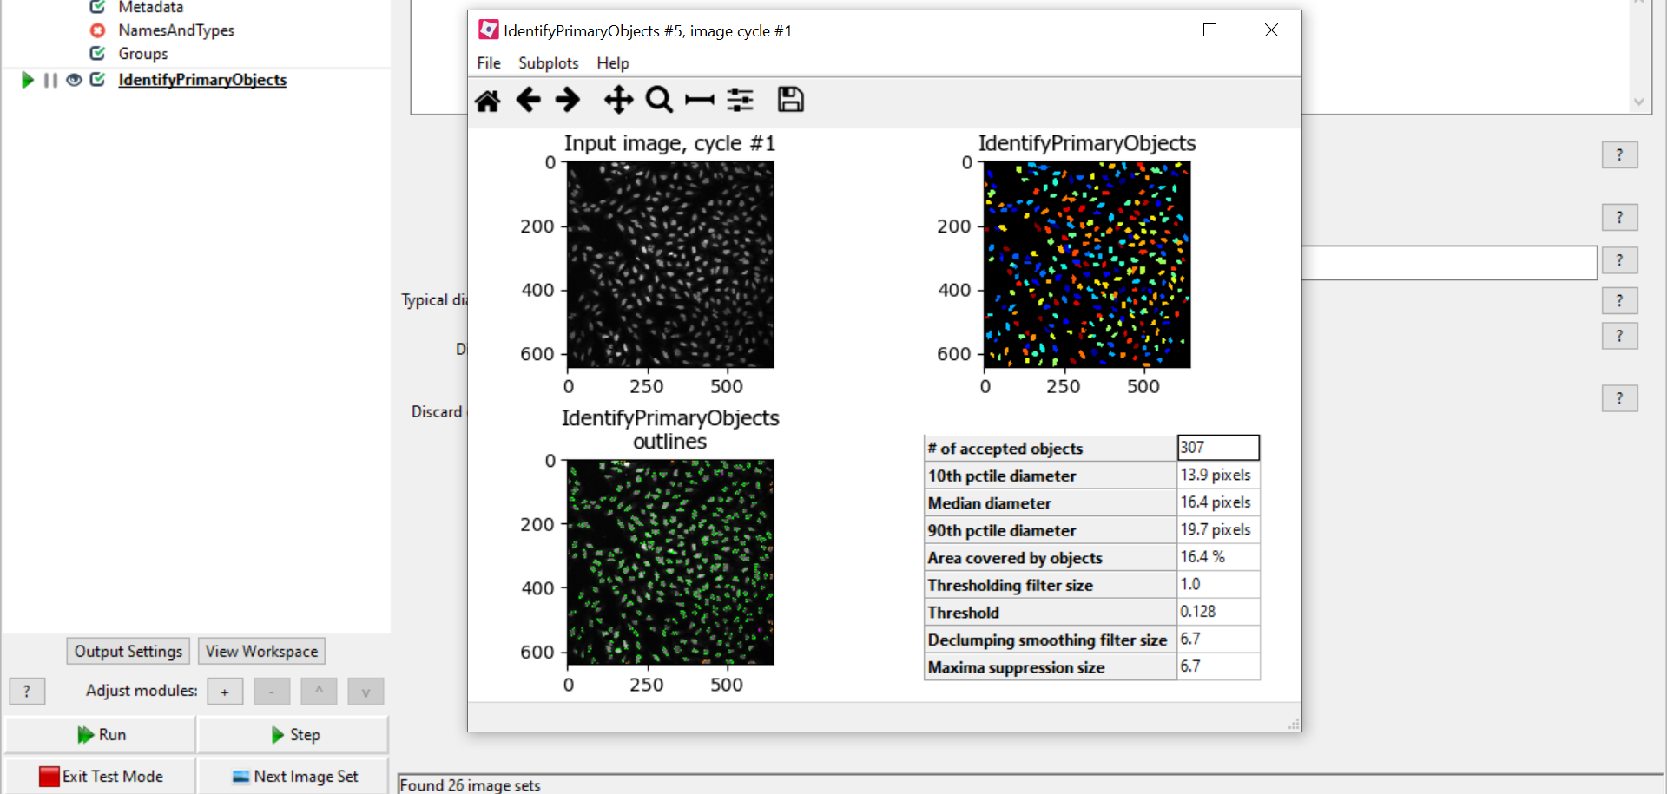
Identify Primary Objects
In Test Mode, click ‘Step’ and a new window should appear.

Slide 27
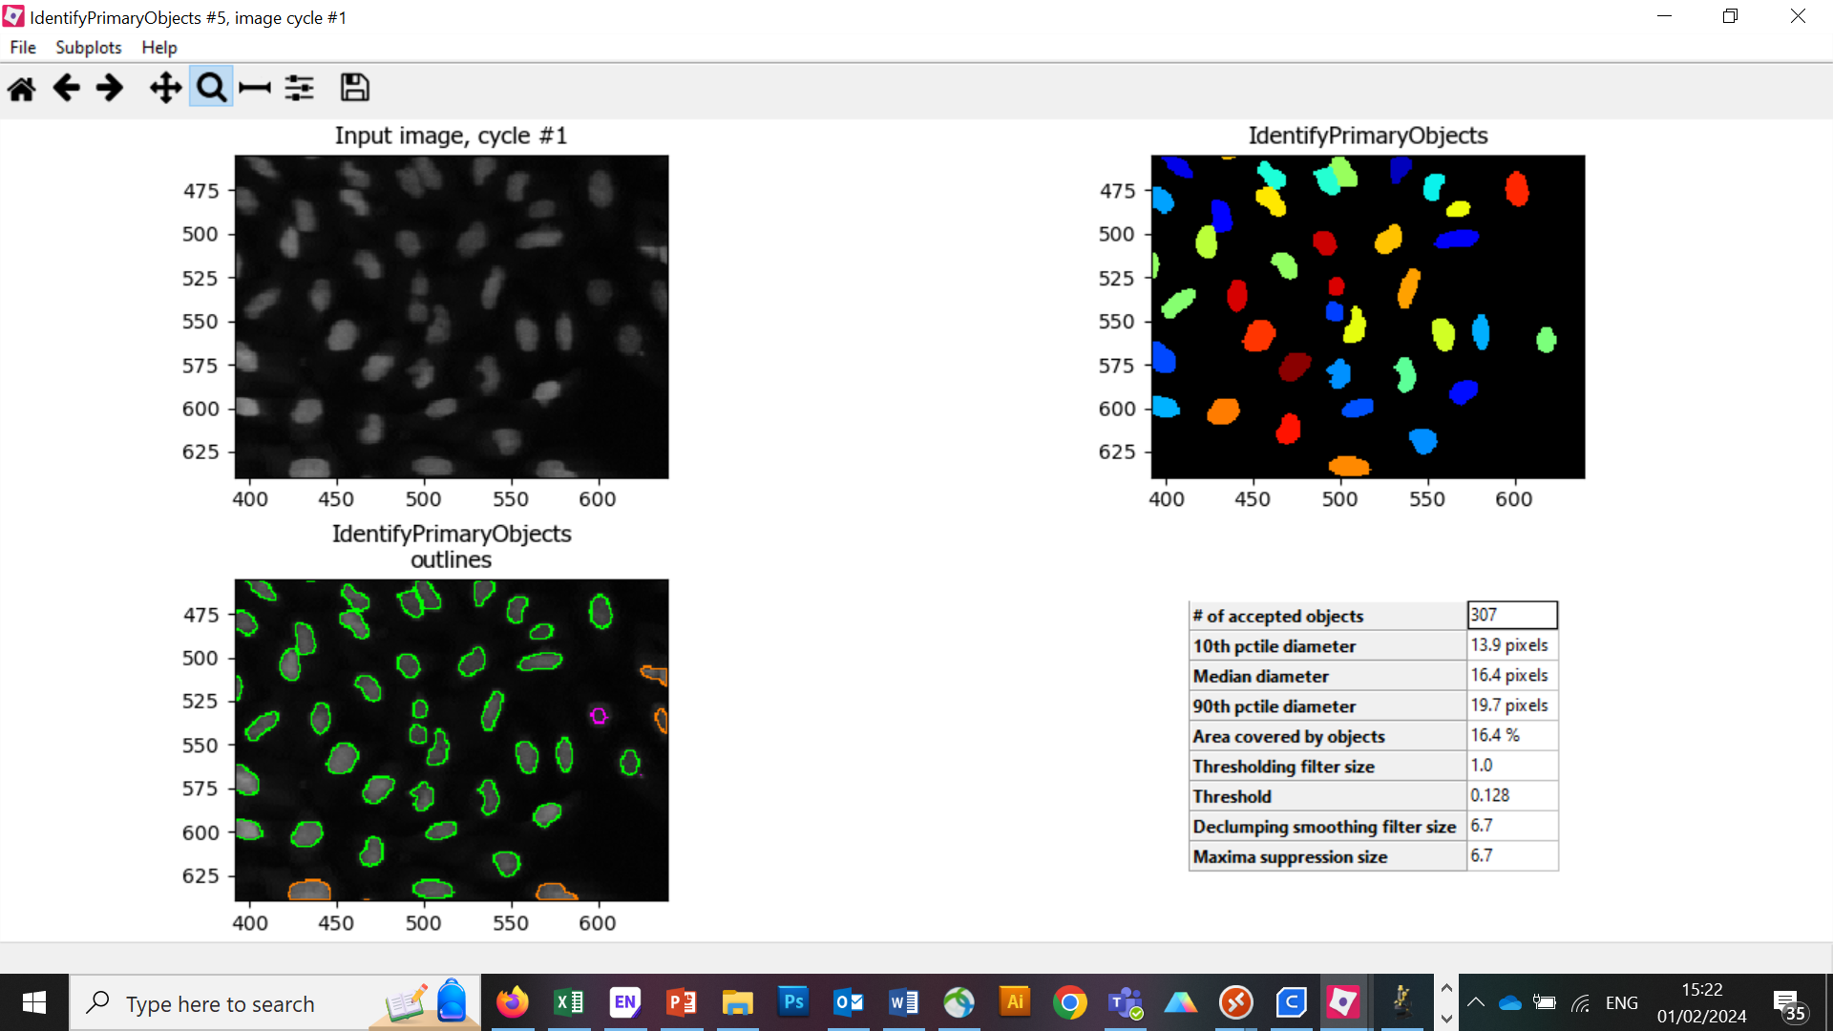
Identify Primary Objects
Use the zoom and home buttons to check the segmentation.
Green objects are accepted, pink and orange objects are rejected.
Note the number of accepted objects is 307.

Slide 28
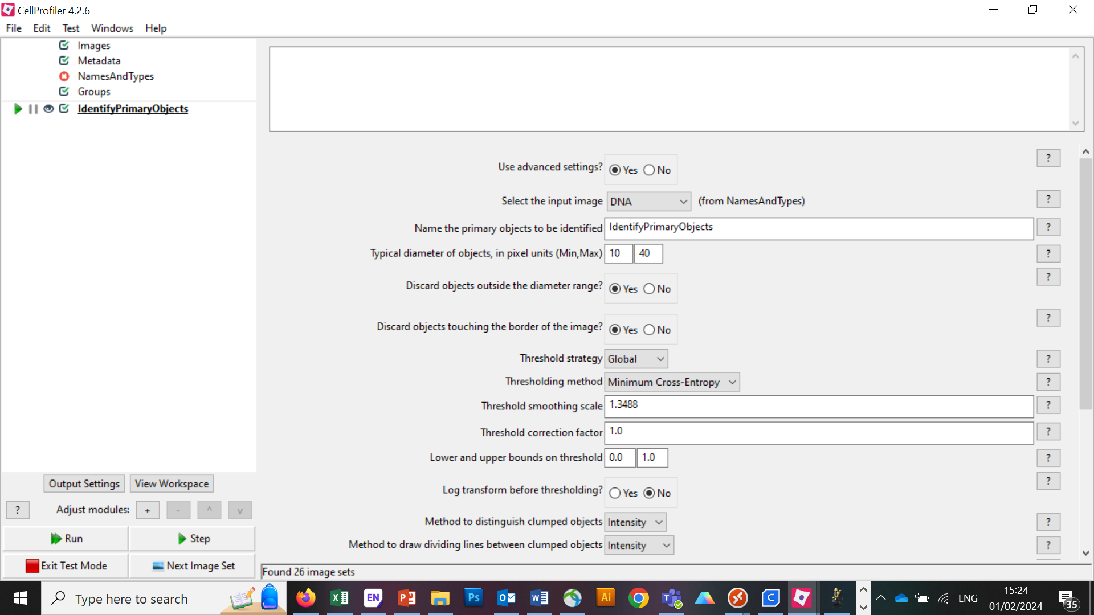
Identify Primary Objects
Usually more advanced segmentation is required.

Slide 29
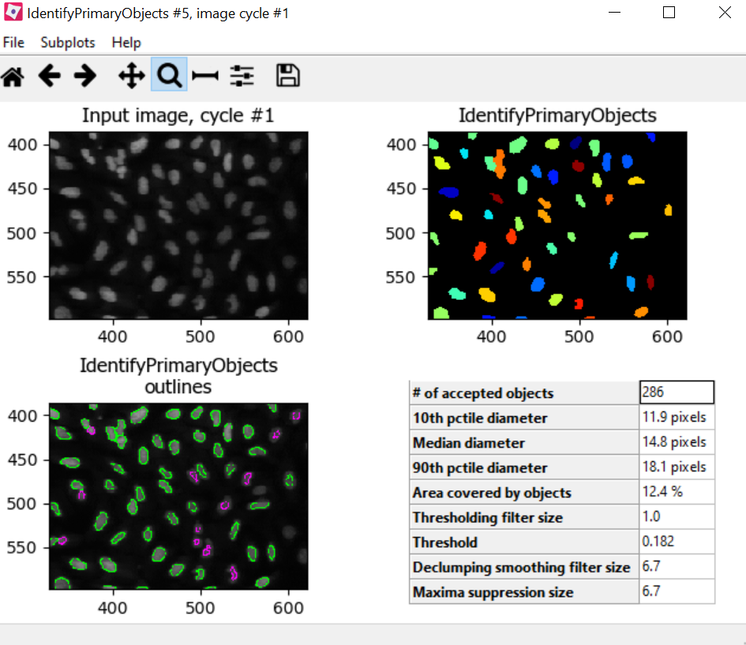
Identify Primary Objects
Change the Thresholding Method to ‘Otsu’ and click Step.

Slide 30
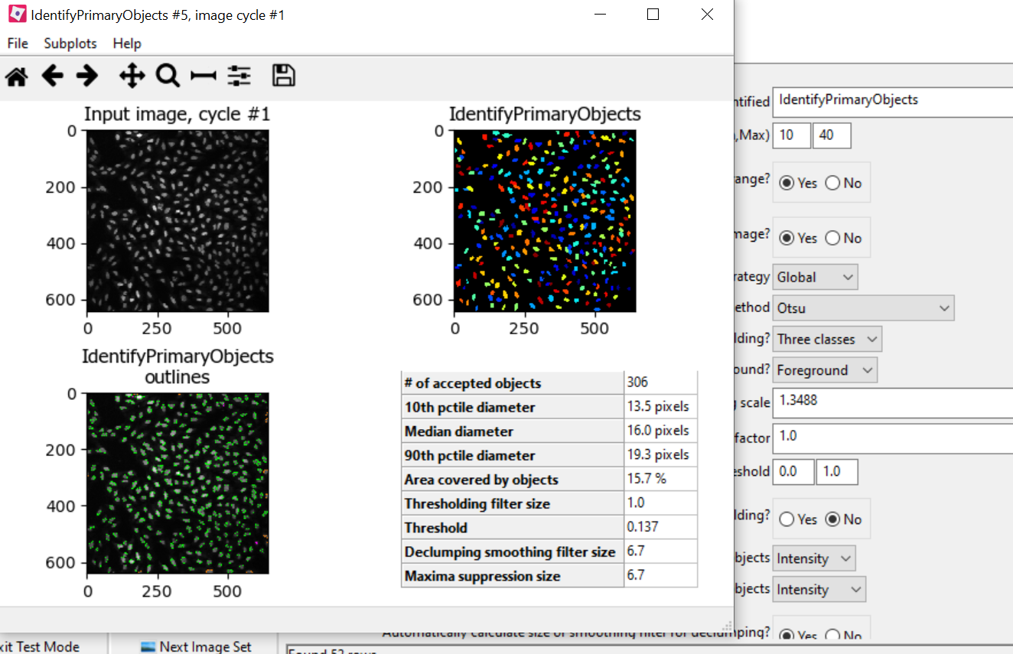
Identify Primary Objects
Use ‘Three classes’ thresholding and click Step.

Slide 31
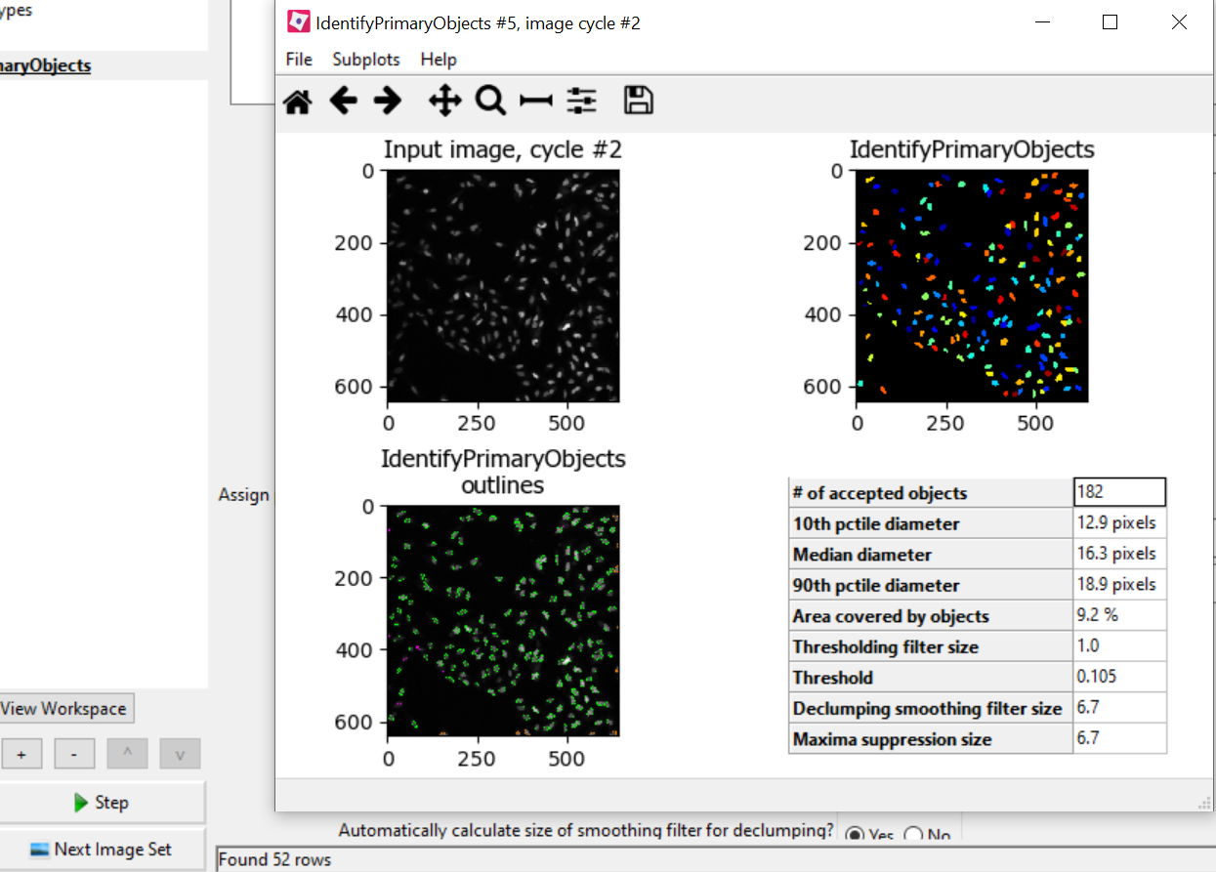
Test with Next Image Set
Click ‘Next Image Set’ and click Step.

Slide 32
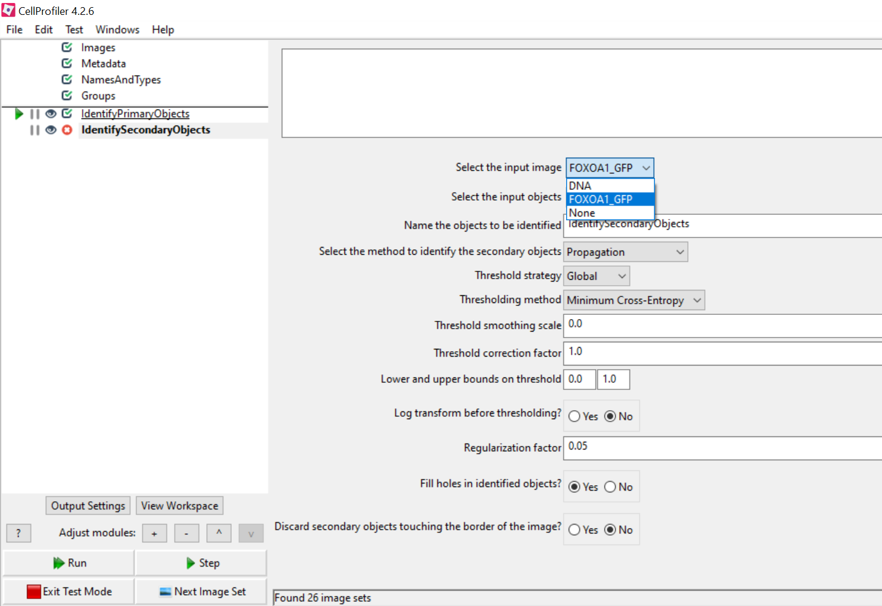
Identify Secondary Objects
Add an ‘Identify Secondary Objects’ module. Select the input image as FOXOA1_GFP.

Slide 33
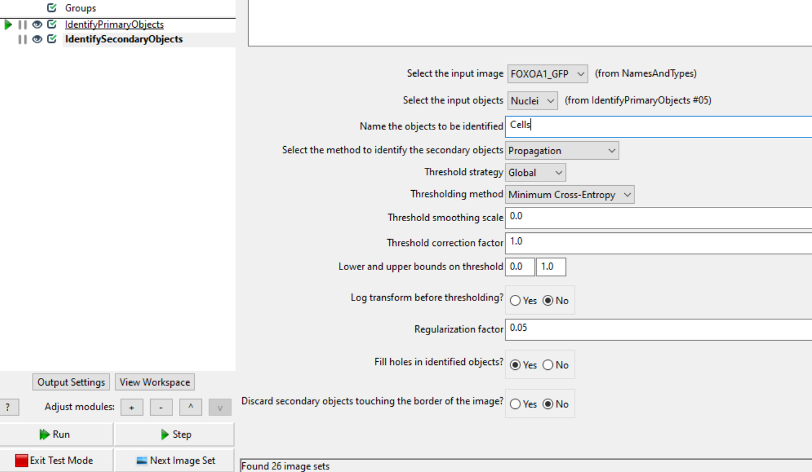
Identify Secondary Objects
Select the Input objects as the Primary Objects (Nuclei). CP will use the Nuclei objects to find the secondary objects more easily. Call the objects ‘Cells’.

Slide 34
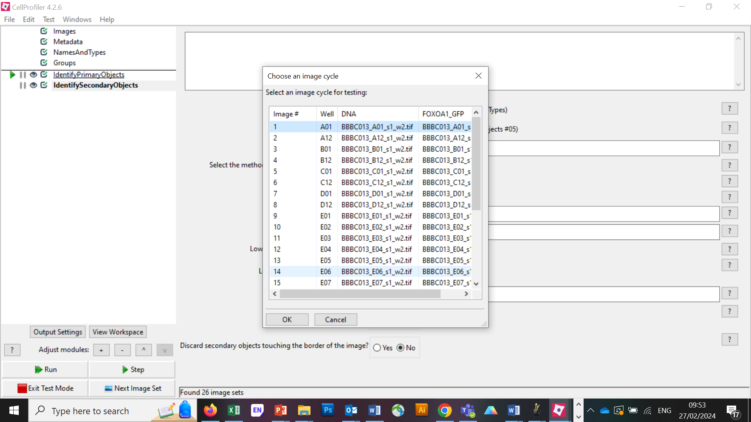
Identify Secondary Objects
In the top left click Test and Choose Image Cycle. Select number 1 (A01) and click ok.

Slide 35
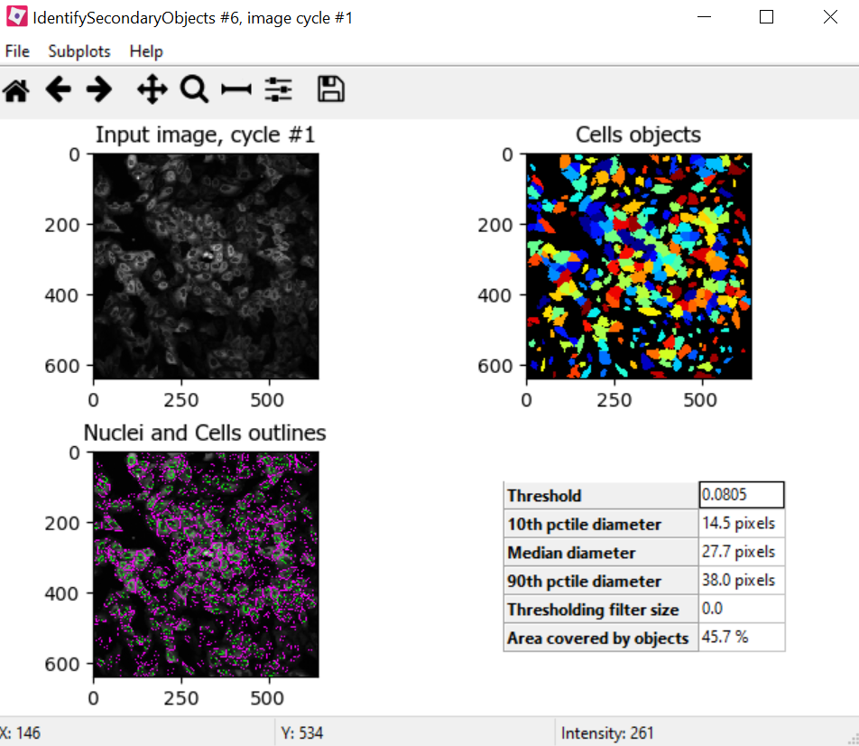
Identify Secondary Objects
Click Step twice. You should now have cell outlines in magenta. Zoom in to check.

Slide 36
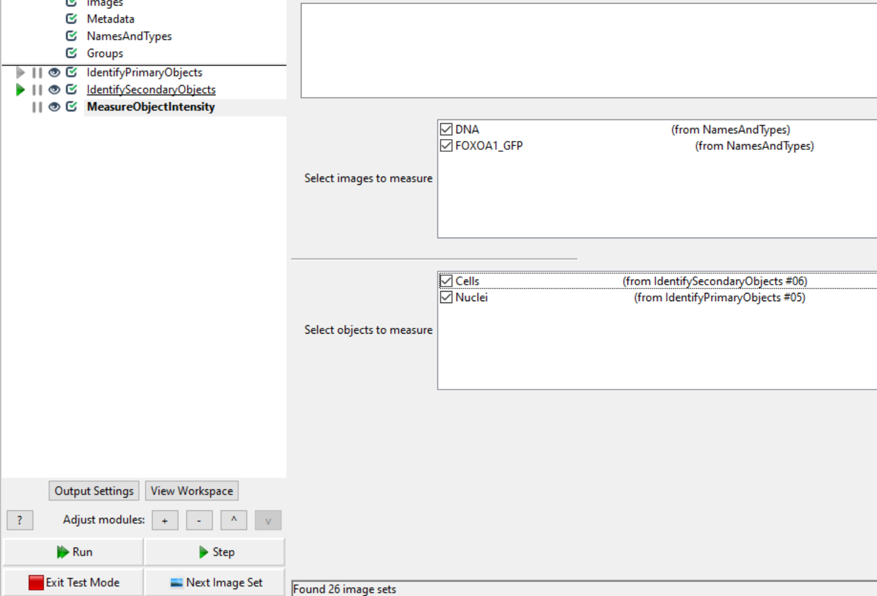
Measure Object Intensity
Add the MeasureObjectIntensity module and tick everything. Click Step until a table of numbers appears.

Slide 37
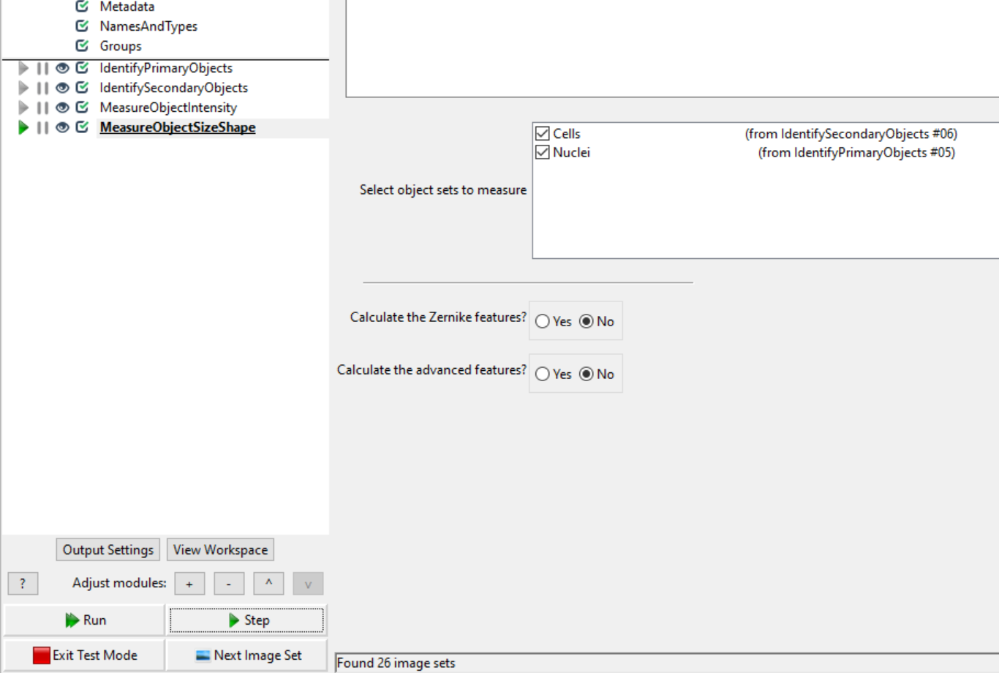
Measure Object Size Shape
Add the MeasureObjectSizeShape module and tick both. Do not calculate Zernike or advanced feastures. Click Step until another table of numbers appears.

Slide 38
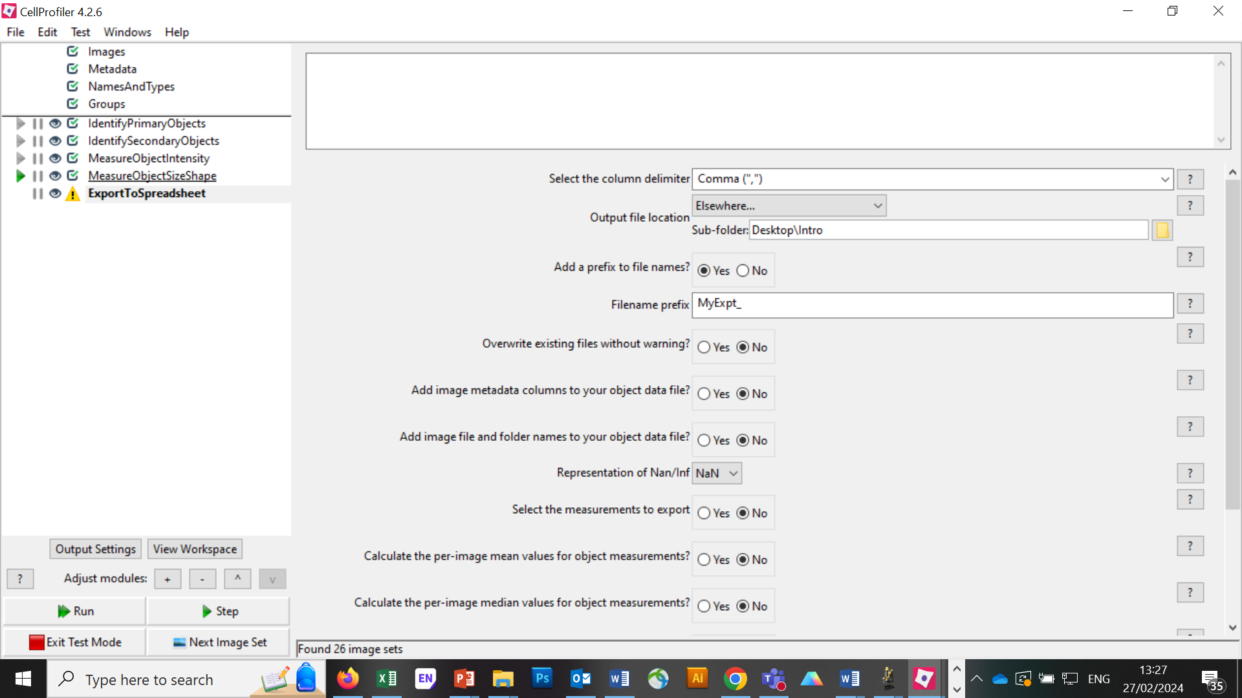
Export Data to Spreadsheet
Add the ExportDatatoSpreadsheet module. Make a New Folder on your Desktop called ‘Intro’. Output file location to Elsewhere and find this folder.

Slide 39

Export Data to Spreadsheet
Important: Calculate the per image Mean, click yes.

Slide 40
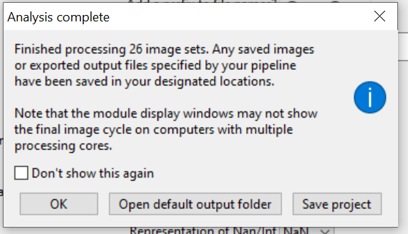
Run Analysis on All Images
Exit Test Mode. Click Analyse Images and watch what happens!
Mine took less than ~2mins. Save your project (do this frequently!).
Throughout today, please save your projects frequently. When we start a new project, please close CP and re-open to start a new one.

Slide 41
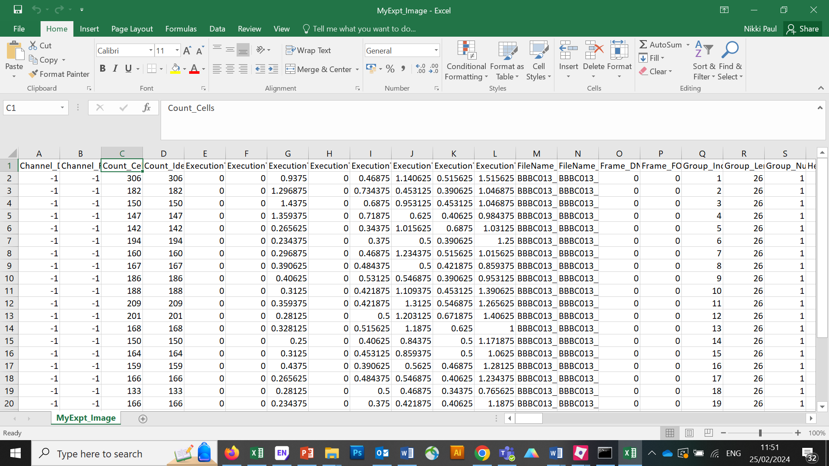
Run Analysis on All Images
Navigate to the ‘Intro’ folder you made on the Desktop. There should be 4 .csv files in this folder. Open the ‘Image’ file in Excel.

Slide 42
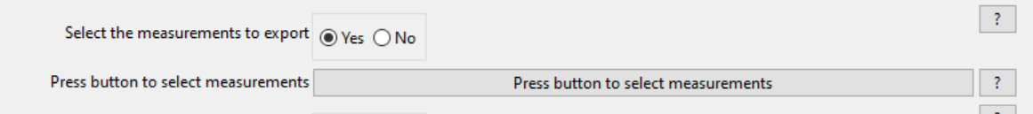
Run Analysis on All Images
It is easy to export too many measurements, and this can become very confusing.
It is possible to get the numbers for every object segmented (see other .csv files).
I usually export the Mean values, and look at the ‘Image’ file.
I will select which measurements to export, to make things more manageable.

Slide 43
Important to Remember
Dates in yyyymmdd format.
Avoid spaces and hyphens, use underscores: _
CellProfiler measures everything in pixels (not µm’s etc.). If you need absolute sizes we can add extra steps to the pipeline (CalculateMath), or calculate this in Excel later.
CellProfiler has a habit of putting windows behind the main interface, so check behind. If you end up with a lot of windows open in Test Mode, close them because it can get confusing.
Always check your analysis, don’t assume the computer is 100% correct. You may need to make compromises.
Don’t give up! If you’re analysis doesn’t work for all images, we may be able to add steps that can help.
Check which measurements that you are exporting and that they make sense for your experiment. E.g. you may need counts and not intensity measurements.

Slide 44
Break
I will show you a live example in the next session.

Slide 45
Example pipeline
Intended Learning Outcomes:
Primary objects
Secondary objects
Tertiary objects
Export segmentations as images
Measurements
Export measurements

Slide 46
Example pipeline
Nuclei (w1), ER (w2), Nucleoli (w3), ActinGolgiPM (w4), Mitochondria (w5).
Primary Objects Hoescht, 10-150, Otsu3, Shape Shape
Secondary objects ActinGolgiPM, Propagation, use threshold correction
Tertiary Objects, new = cytoplasm, larger = cells, smaller = nuclei.
Enhance Nucleoli – speckles, 10,
Mask image, filtered nucleoli by nuclei.
Identify primary on nucleoli.2-15, intensity shape, Otsu.
Overlay outlines of orignucleoli, outline inner, nuclei and nucleoli,
Save this image.
Relate objects, Nuclei and Nucleoli,
Measure object size shape, select all.
Export to spreadsheet. Calculate means and select the measurements to export. Include filename.

Slide 47
Lunch
Back at 1pm.

Slide 48
3 examples to work through
CellProfiler Workshop 1
CPW1_Example_Human
CellProfiler Workshop 2
CPW2_Example_5channel
CellProfiler Workshop 3
CPW2_Example_3DSegmentation
Please ask for help when you need it ☺

Slide 49
Menti poll
What will you use CellProfiler to analyse?
https://www.menti.com/alktmno6q7dj
Go to menti.com and enter code: 8970 7880

Slide 50
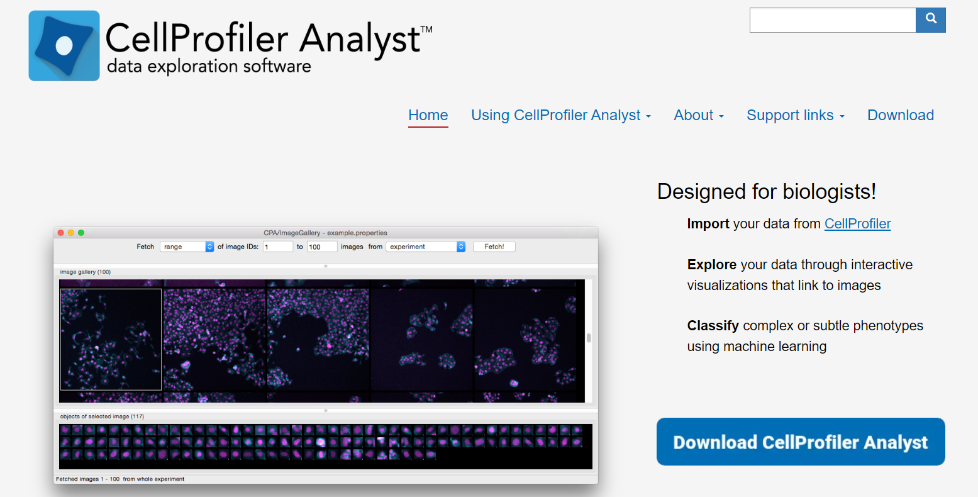
CellProfiler Analyst
Machine Learning and classification using CellProfiler data:
https://cellprofileranalyst.org/

Slide 51
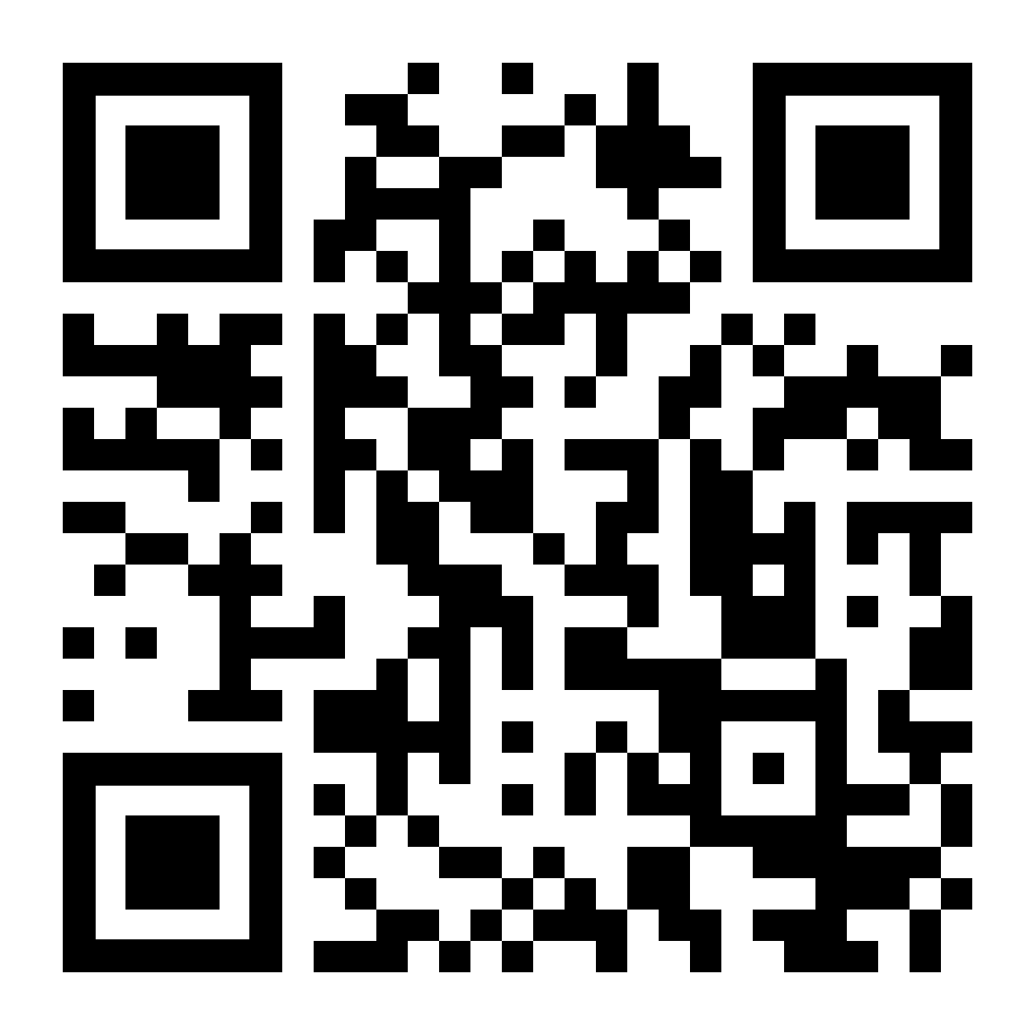
Feedback Form
Feedback greatly appreciated!
https://forms.gle/oDcrFAD87aZdW21c8

